Slide 1
AIR POLLUTANTS TRANSPORT
AND
ACID RAIN

Slide 2
Primary and Secondary Pollutants
Air pollutants occur either as gases or particulate matter
Primary air pollutants
Secondary pollutants

Slide 3
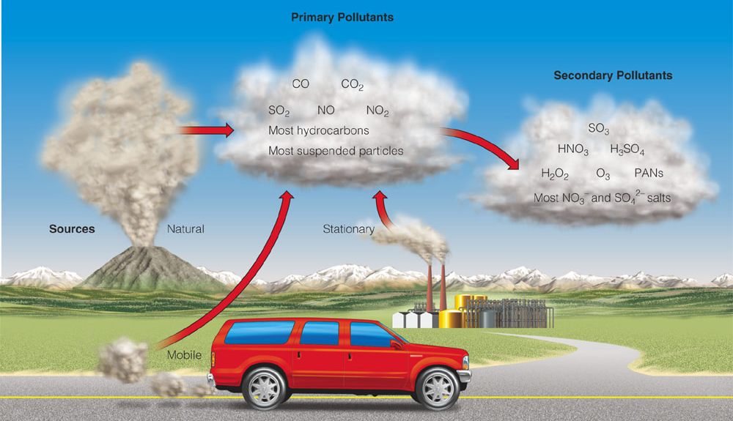
Outdoor Air Pollution
Primary - Released directly from planet’s surface. Dust, smoke particles, Nitrogen, Carbon etc.
Secondary - Formed when primary pollutants react or combine with one another, or basic elements.

Slide 4
Carbon Monoxide
Sulphur Dioxide
Produced by burning of organic material (coal, gas, wood, trash, etc.) Automobiles biggest source (80%) Cigarette smoke another major source Toxic because binds to hemoglobin, reduces oxygen in blood Not a persistent pollutant, combines with oxygen to form CO2 Most communities now meet EPA standards, but rush hour traffic can produce high CO levels
Produced by burning sulfur containing fossil fuels (coal, oil) Coal-burning power plants major source Reacts in atmosphere to produce acids One of the major components of acid rain When inhaled, can be very corrosive to lung tissue
Nitrogen Oxides
Hydrocarbons
Hydrocarbons - organic compounds with hydrogen, carbon From incomplete burning or evaporated from fuel supplies Major source is automobiles, but some from industry Contribute to smog Improvements in engine design have helped reduce
Produced from burning of fossil fuels Contributes to acid rain, smog Automobile engine main source New engine technology has helped reduce, but many more cars

Slide 5
Particulates
Particulates - small pieces of solid materials and liquid droplets (2.5 mm and 10 mm) Examples: ash from fires, asbestos from brakes and insulation, dust Easily noticed: e.g. smokestacks Can accumulate in lungs and interfere with the ability of lungs to exchange gases. Some particulates are known carcinogens Those working in dusty conditions at highest risk (e.g., miners)

Slide 6
Major Air Pollutants: Problems
Sulfur dioxide - acid rain, health damage, visibility reduction
Nitrogen oxides - acid rain, eutrophication, growth of weedy species
Carbon monoxide - inhibited respiration
Lead and mercury - neurological damage
Chlorofluorocarbons - ozone depletion
Volatile organic compounds – (isoprenes, terpenes, methane, & benzene, chloroform, etc) oxidized to CO, CO₂ in the atmosphere; carcinogens?
6

Slide 7
Secondary Air Pollutants
Ozone (O3)
PANs (Peroxyacetyl nitrate)
Aldehydes
all three formed by interaction between NOx and VOCs.
Note: - Ozone is a pollutant in the troposphere, but natural and beneficial in the stratosphere

Slide 8
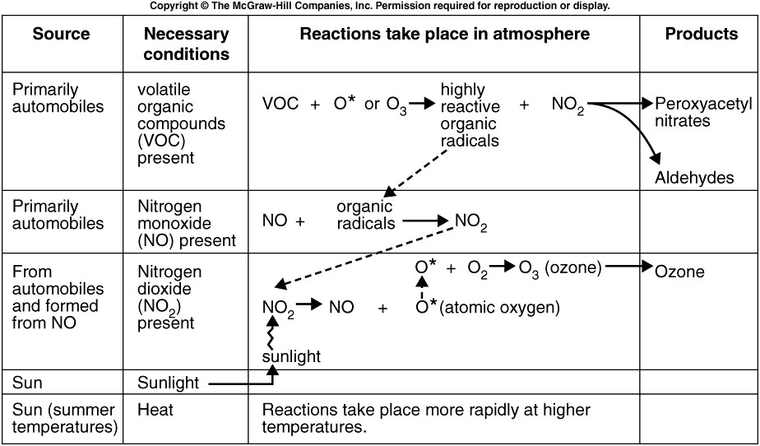

Slide 9
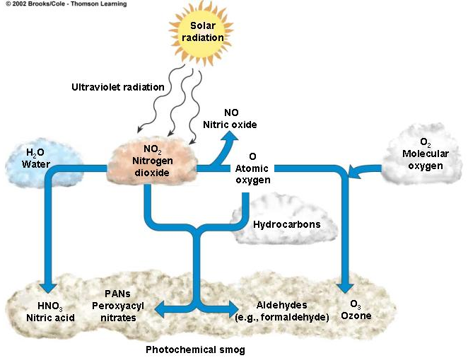
Photochemical Smog
Some primary pollutants react under the influence of sunlight (photochemical reaction), including NO_{x}, O₃, PANs..

Slide 10
Transport of Air Pollutants
By
different types of winds

Slide 11
What is wind?
Wind is air in motion. It is produced by the uneven heating of the earth’s surface by the sun.
What causes the wind to blow?
As the sun warms the Earth's surface, the atmosphere warms too. Warm air rise and cold air sink and this movement of air make the wind blow.
What is a monsoon?
A monsoon is a seasonal wind, found especially in Asia that reverses direction between summer and winter and often brings heavy rains.
In the summer, a high pressure area lies over the Indian Ocean while a low exists over the Asian continent. The air masses move from the high pressure over the ocean to the low over the continent, bringing moisture-laden air to south Asia.
During winter, the process is reversed and a low sits over the Indian Ocean while a high lies over the Tibetan plateau so air flows down the Himalaya and south to the ocean.
The migration of trade winds and westerlies also contributes to the monsoons. Smaller monsoons take place in equatorial Africa, northern Australia, and, to a lesser extent, in the southwestern United States.

Slide 12
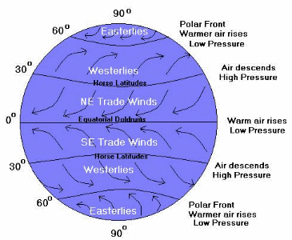
What are the global wind patterns?
The equator receives the Sun's direct rays. Here, air is heated and rises, leaving low pressure areas behind. Moving to about thirty degrees north and south of the equator, the warm air from the equator begins to cool and sink. Between thirty degrees latitude and the equator, most of the cooling sinking air moves back to the equator. The rest of the air flows toward the poles.

Slide 13
Trade winds The trade winds are just air movements toward the equator. They are warm, steady breezes that blow almost continuously. The Coriolis Effect makes the trade winds appear to be curving to the west, whether they are traveling to the equator from the south or north. Doldrums The doldrums is an area of calm weather. The trade winds coming from the south and the north meet near the equator. These converging trade winds produce general upward winds as they are heated, so there are no steady surface winds.

Slide 14
Prevailing westerlies Between thirty and sixty degrees latitude, the winds that move toward the poles appear to curve to the east. Because winds are named from the direction in which they originate, these winds are called prevailing westerlies. Prevailing westerlies in the Northern Hemisphere are responsible for many of the weather movements across the United States and Canada. Polar easterlies At about sixty degrees latitude in both hemispheres, the prevailing westerlies join with the polar easterlies to reduce upward motion. The polar easterlies form when the atmosphere over the poles cools. This cool air then sinks and spreads over the surface. As the air flows away from the poles, it is turned to the west by the Coriolis effect. Again, because these winds begin in the east, they are called easterlies.

Slide 15
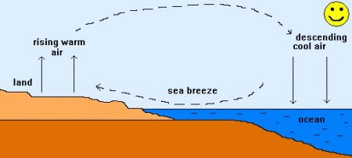
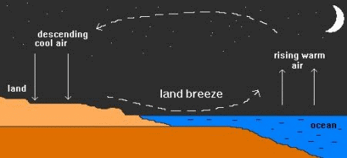
What is a sea breeze? On a warm summer day along the coast, this differential heating of land and sea leads to the development of local winds called sea breezes. As air above the land surface is heated by radiation from the Sun, it expands and begins to rise, being lighter than the surrounding air. To replace the rising air, cooler air is drawn in from above the surface of the sea. This is the sea breeze, and can offer a pleasant cooling influence on hot summer afternoons.
What is a land breeze? A land breeze occurs at night when the land cools faster than the sea. In this case, it is air above the warmer surface water that is heated and rises, pulling in air from the cooler land surface.

Slide 16
The Beaufort scale is an empirical measure for the intensity of the weather based mainly on wind power. The scale was created by the British naval commander Sir Francis Beaufort around 1806.
Beaufort number | Wind speed MPH | Wind Speed Knots | Description | Sea conditions | Land conditions
0 | <1 | <1 | Calm | Flat | Calm
1 | 1-3 | 1-3 | Light air | Ripples without crests | Wind motion visible in smoke
2 | 4-7 | 4-6 | Light breeze | Small wavelets | Leaves rustle
3 | 8-12 | 7-10 | Gentle breeze | Large wavelets | Smaller twigs in constant motion
4 | 13-18 | 11-16 | Moderate breeze | Small waves | Small branches begin to move
5 | 19-24 | 17-21 | Fresh breeze | Moderate longer waves | Smaller trees sway
6 | 25-31 | 22-27 | Strong breeze | Large waves with foam crests | Large branches in motion
7 | 32-38 | 28-33 | Near gale | Sea heaps up and foam begins to streak | Whole trees in motion
8 | 39-46 | 34-40 | Gale | Moderately high waves with breaking crests | Twigs broken from trees
9 | 47-54 | 41-47 | Severe gale | High waves with dense foam | Light structure damage
10 | 55-63 | 48-55 | Storm | Very high waves. The sea surface is white | Trees uprooted. Considerable structural damage
11 | 64-72 | 56-63 | Violent storm | Exceptionally high waves | Widespread structural damage
12 | 73-82 | 64-71 | Hurricane | Sea completely white with driving spray. | Massive and widespread damage to structure

Slide 17
WHAT IS ACID RAIN?
Acid rain is rain that is more acidic than normal.
Acid rain's spread and damage involves weather, chemistry, soil, and the life cycles of plants and animals on the land and from acid rain in the water.
Sulfur dioxide and nitrogen oxides, the major sources of acid rain.

Slide 18
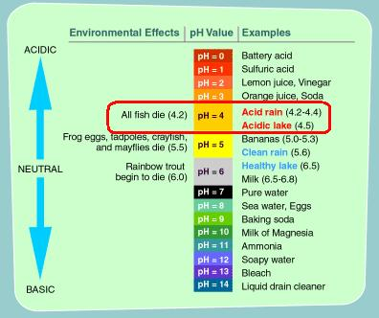
Measurement of acidity of Rain

Slide 19
TYPES OF ACID RAIN

Slide 20
Acid Rain
Wet Deposition:-
Wet deposition refers to acidic rain, fog, and snow. As this acidic water flows over and through the ground, it affects a variety of plants and animals.
Dry Deposition:-
Dry deposition refers to acidic gases and particles. About half of the acidity in the atmosphere falls back to earth through dry deposition

Slide 21
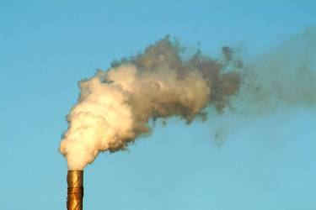
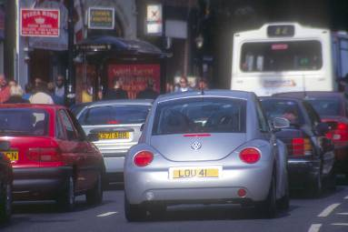
CAUSES OF ACID RAIN
Burning coal, Oil and natural gas, in power stations makes electricity, giving off sulphur dioxide gas.
Burning petrol and oil in vehicle engines gives off nitrogen oxides as gases.
These gases mix with water vapour and rainwater in the atmosphere producing weak solutions of sulphuric and nitric acids – which fall as acid rain.

Slide 22
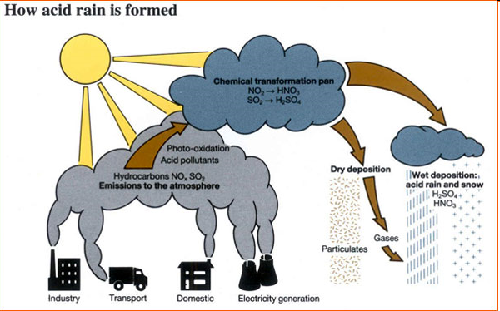

Slide 23
Effects Of Acid Rain

Slide 24
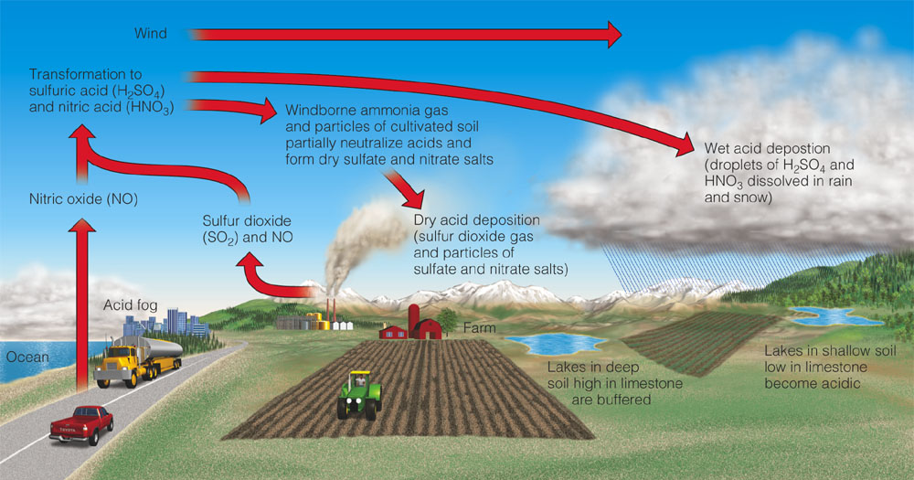
Air Pollution from Acid Deposition
Wet deposition
Dry deposition

Slide 25

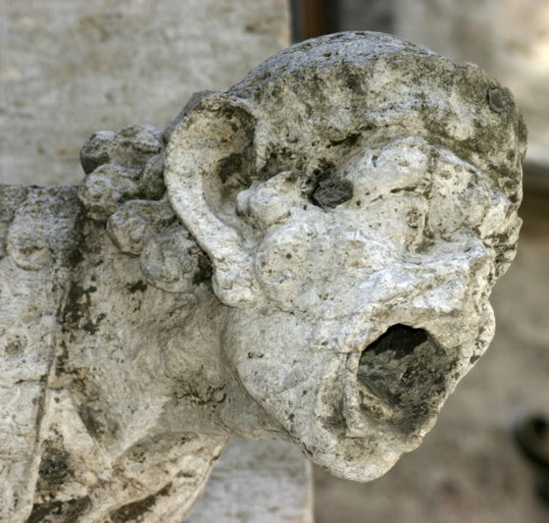
Effect on non-living
The Taj Mahal in Agra, suffering from sulphur di oxide, sulphuric acid and other fumes pollutants released from Mathura Refinery.
Acid Rain causes extensive damage to building, statues, bridges, & structural materials of marble, lime stone, etc.

Slide 26
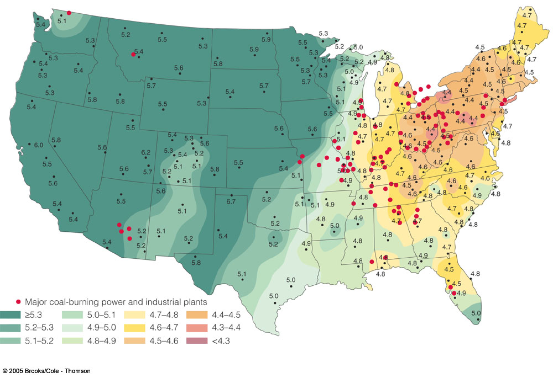
Acid Deposition in the US

Slide 27
Acid Deposition and Humans
Respiratory diseases
Toxic metal leaching
Damage to structures, especially containing calcium carbonate
Decreased visibility
Decreased productivity and profitability of fisheries, forests, and farms

Slide 28
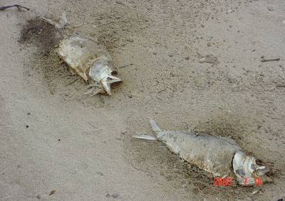
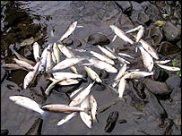
On Water Animals
Acid Rain increases the acidity of lakes & rivers, which is directly effect the aquatic ecosystem.

Slide 29
On Trees & Soil
Acid Rain dissolves all the nutrients and the useful minerals for the tree to grow.
Weakens the process of photosynthesis.
Acid Rain leaches potassium, calcium, magnesium, etc essential elements from the top of soil & When soil is contaminated, cereal (arable) production crops.
Acids activate aluminium from the soil which leaches into water and fish die. Drinking water is contaminated.

Slide 30
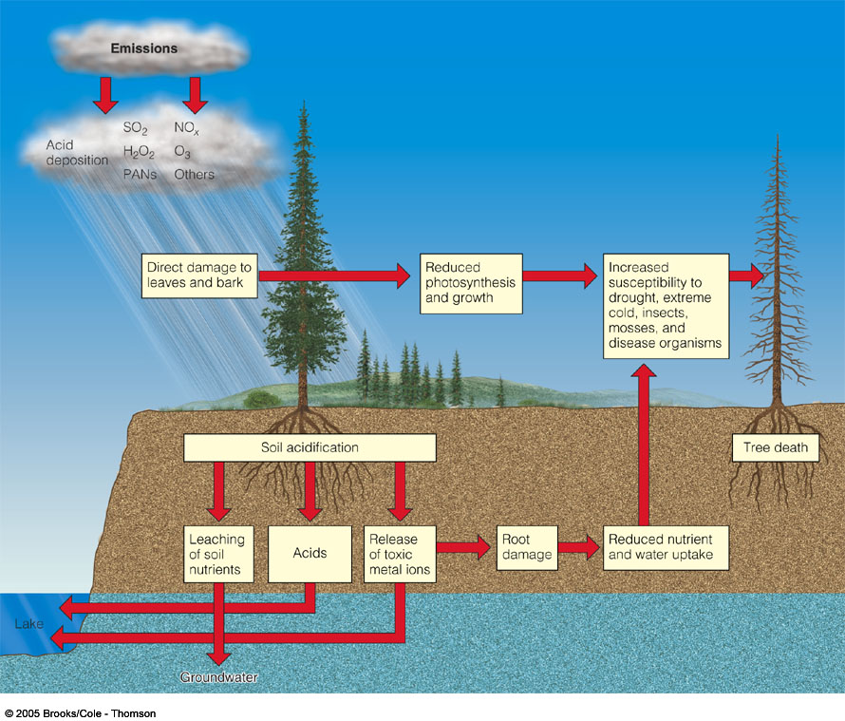
Acid Deposition, Plants, and Soil
Nutrient leaching
Heavy metal release
Weakens trees

Slide 31
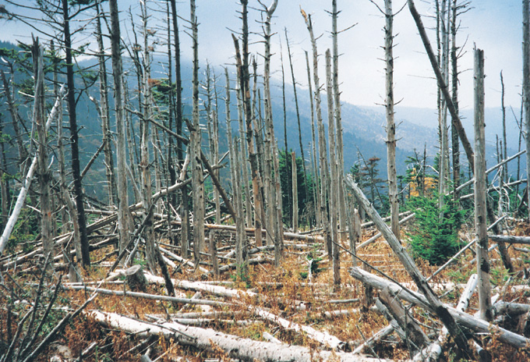
Mountains of North Carolina
Acid Rainfall affects:
Plants - directly (weakens or kills plants)
Plants - indirectly (lower soil nutrients,
insects attack weak trees)
Soils - directly (leaching of base cations eg, Ca & Mg)
31
Notes:
Typically, negative impacts on ecosystems are complicated and not necessarily due to one single factor. Negative impacts in the Appalachian Mountains of North Carolina, such as these at Mount Mitchell, are likely to be due to multiple impacts, that may be very difficult to understand completely. In the case of this Frazier fir stand, the Balsam Wooly adelgid, and insect similar to an aphid, actually killed the trees. However, it is likely that stresses such as those from atmospheric deposition in the region made the trees more susceptible to attack by the aphid. Many scientists have all argued about the reasons responsible for buybacks such as these on Mount Mitchell, but there is no resolution to the exact causes.

Slide 32
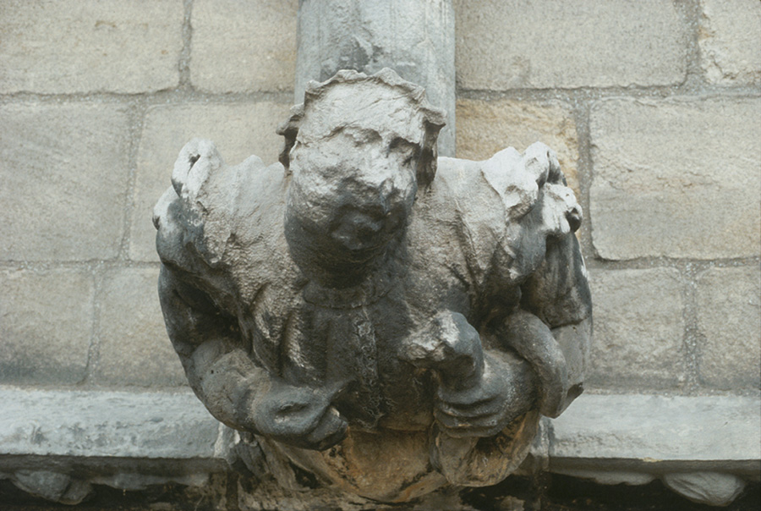
32

Slide 33
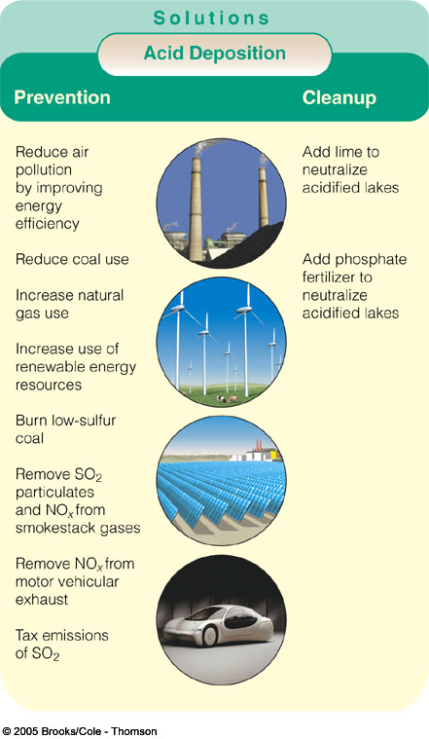
Solutions to Acid Deposition

Slide 34
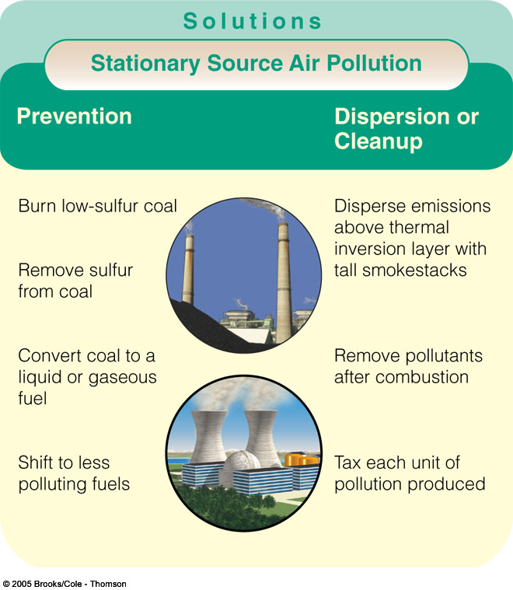
Emission Reduction

Slide 35
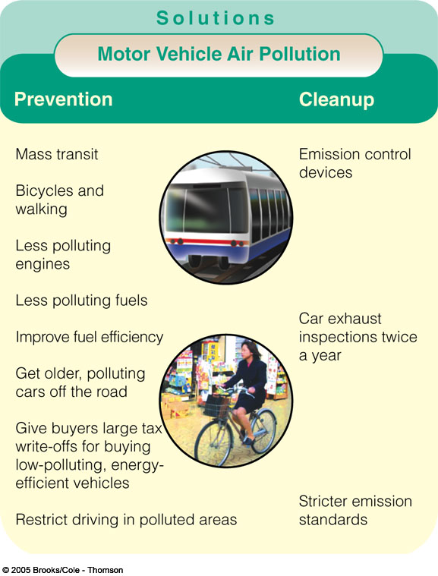
Reducing Motor Vehicle Air Pollution

Slide 36
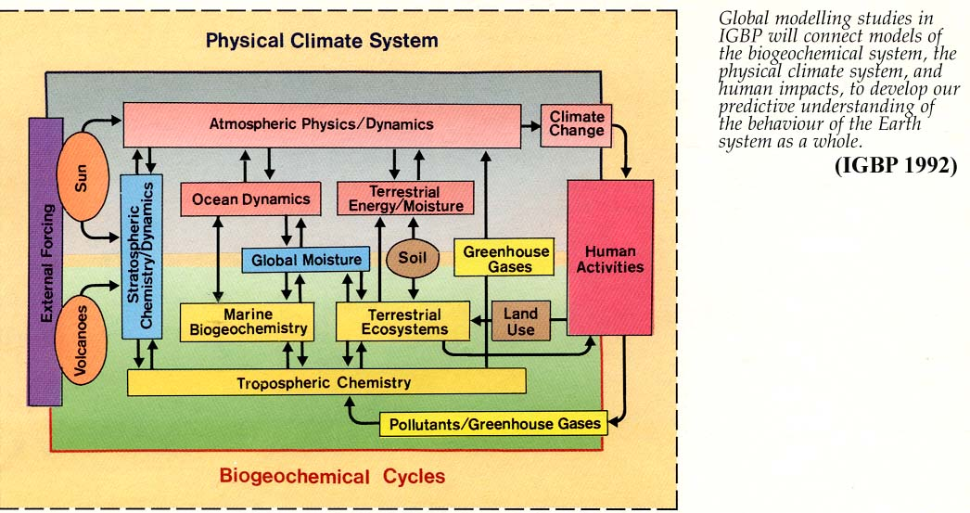
36
Notes:
The International Geosphere-Biosphere Programme (IGBP) is a research program that studies the phenomenon of Global Change

Slide 37
Air Pollution Control
Early approach: “Dilution is the solution to pollution”
Particulate removal - air filters
Sulfur removal - scrubbers
Nitrogen oxide reduction - catalytic converters
Hydrocarbon controls - afterburners
37

Slide 38
CLEAN AIR LEGISLATION
Clean Air Act (1963) - First national air pollution control. (using incentives, eg federal grants to states)
Clean Air Act (1970) rewrote original Act.
Identified critical pollutants
Established ambient air quality standards.
Primary Standards - Human health
Secondary Standards - Materials, environment
38

Slide 39
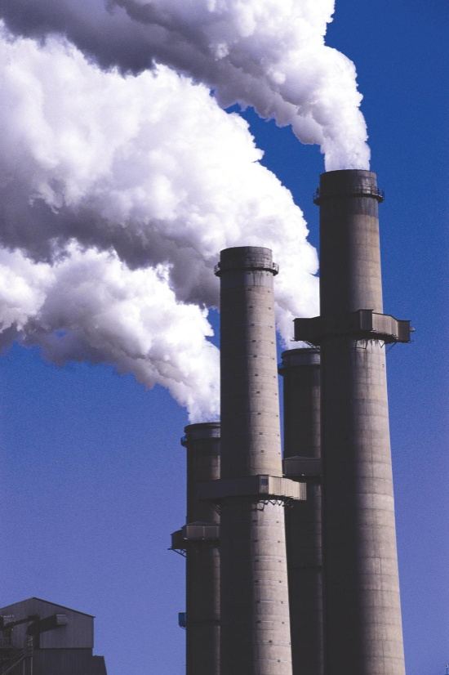
Conventional Pollutants
US Clean Air Act designated seven major (conventional or criteria) pollutants for which maximum ambient air levels are mandated.
Sulfur Dioxide
Carbon Monoxide
Particulates
Hydrocarbons
Nitrogen Oxides
Photochemical Oxidants
Lead
39

Slide 40
Clean Air Act
Revision (1990) - Included provision for:
Acid Rain
Urban Smog
Toxic Air Pollutants
Ozone Protection
Marketing Pollution Rights
Ambient ozone and dust.
NO_{x} emissions
40
Notes:
new source review – industry has to have pollution control on old plants

Slide 41
Clean Air Act
Clean Air Interstate Rule (CAIR – 2005)
Eliminated ‘new source review’,
Set emission standards for SO₂, NOx, PM
Depends upon ‘cap-and-trade’ (can buy credits from nonpolluting)
OK nationally but can create ‘hot spots’ of pollution locally
Interstate rule because pollution can drift across state borders affecting ambient pollution levels
41
Notes:
new source review – industry has to have pollution control on old plants

Slide 42
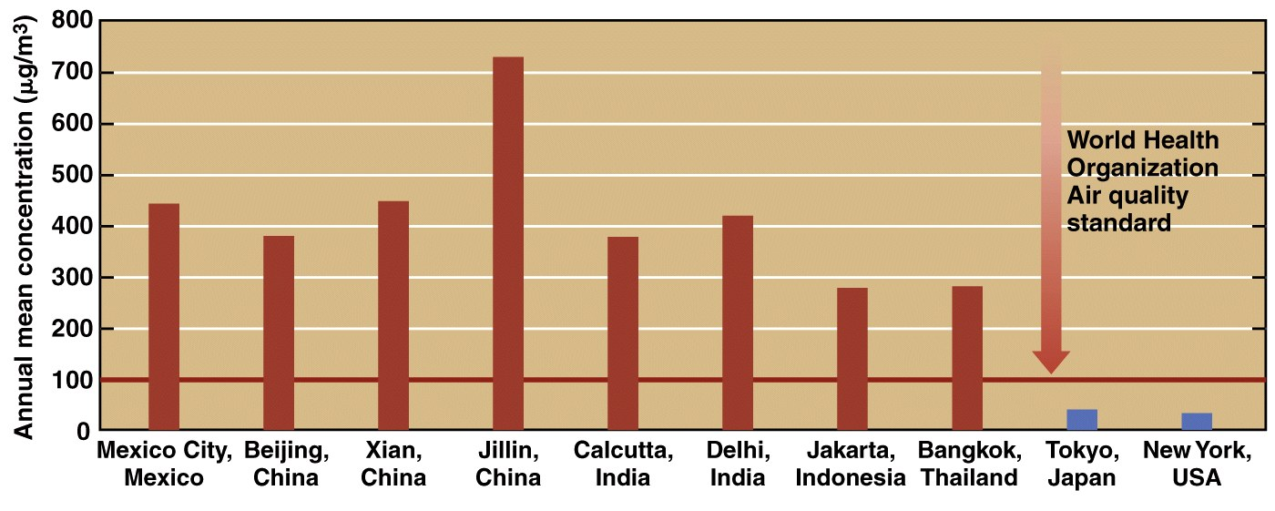
Total Suspended Particulates (TSP)
Tend to be much higher in large cities in developing countries than in developed countries

Slide 43
CURRENT AND FUTURE CONDITIONS
In the United States, air quality has improved dramatically in the last decade in terms of major large-volume pollutants.
Cities where pollution is largely from traffic still have serious air quality problems.
Major metropolitan areas of many developing countries are growing at explosive rates, and environmental quality is very poor.
43

Slide 44
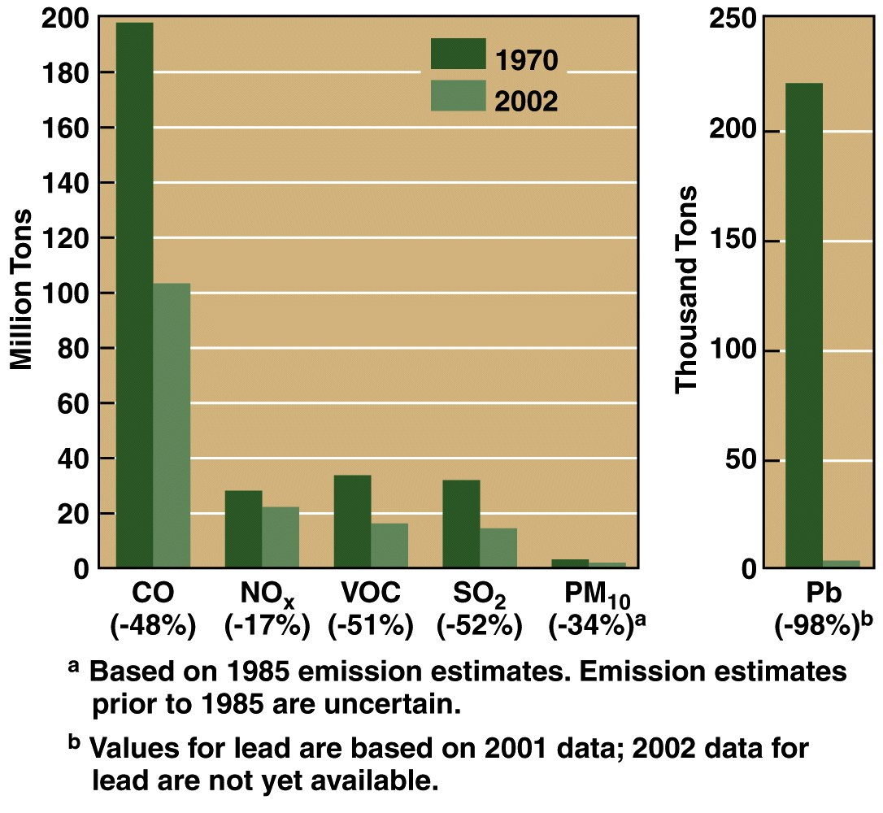
U.S. emissions of six major air pollutants
in 1970 compared with 2002
44
Notes:
For instance, figure 9.29 in the text shows reductions in carbon monoxide, volatile organic carbon, particulate matter, and sulfur dioxide since 1970-. Note also, that Pb the emissions into the air had been reduced almost completely to zero due primarily to the removal of lead as an additive to gasoline. In old figure it showed that nitrous oxide emissions had actually increased during that period of time because it is very difficult to adjust automobiles to reduce these emissions, and the number of automobiles and the actual miles driven has greatly increased during that period of time throughout the United States.

